Slide 1
CI-CSE-5203
Fuzzy Logic
Department of Computer Science and Engineering
Comilla University, Cumilla

Slide 2
Introduction, or what is fuzzy thinking?
Experts rely on common sense when they solve problems.
How can we represent expert knowledge that uses vague and ambiguous terms in a computer?
Fuzzy logic is not logic that is fuzzy, but logic that is used to describe fuzziness.
Fuzzy logic is based on the idea that all things admit of degrees. Temperature, height, speed, distance, beauty – all come on a sliding scale.
Fuzzy logic relies on the concept of a fuzzy set.
Notes:
Fuzzy logic has rapidly become one of the most successful of today's technologies for developing sophisticated control systems. The reason for which is very simple.
Fuzzy logic addresses such applications perfectly as it resembles human decision making with an ability to generate precise solutions from certain or approximate information.
It fills an important gap in engineering design methods left vacant by purely mathematical approaches (e.g. linear control design), and purely logic-based approaches (e.g. expert systems) in system design.

Slide 3
Boolean logic uses sharp distinctions. It forces us to draw lines between members of a class and non- members. For instance, we may say, Tom is tall because his height is 181 cm. If we drew a line at 180 cm, we would find that David, who is 179 cm, is small. Is David really a small man or we have just drawn an arbitrary line in the sand?
Fuzzy logic reflects how people think. It attempts to model our sense of words, our decision making and our common sense. As a result, it is leading to new, more human, intelligent systems.

Slide 4
Fuzzy, or multi-valued logic was introduced in the 1930s by Jan Lukasiewicz , a Polish philosopher. While classical logic operates with only two values 1 (true) and 0 (false), Lukasiewicz introduced logic that extended the range of truth values to all real numbers in the interval between 0 and 1. He used a number in this interval to represent the possibility that a given statement was true or false. For example, the possibility that a man 181 cm tall is really tall might be set to a value of 0.86. It is likely that the man is tall. This work led to an inexact reasoning technique often called possibility theory.

Slide 5
In 1965 Lotfi Zadeh, published his famous paper “Fuzzy sets”. Zadeh extended the work on possibility theory into a formal system of mathematical logic, and introduced a new concept for applying natural language terms. This new logic for representing and manipulating fuzzy terms was called fuzzy logic, and Zadeh became the Master of fuzzy logic.

Slide 6
Why fuzzy?
As Zadeh said, the term is concrete, immediate and descriptive; we all know what it means. However, many people in the West were repelled by the word fuzzy , because it is usually used in a negative sense.
Why logic?
Fuzziness rests on fuzzy set theory, and fuzzy logic is just a small part of that theory.

Slide 7
Fuzzy logic is a set of mathematical principles for knowledge representation based on degrees of membership.
Unlike two-valued Boolean logic, fuzzy logic is multi-valued. It deals with degrees of membership and degrees of truth. Fuzzy logic uses the continuum of logical values between 0 (completely false) and 1 (completely true). Instead of just black and white, it employs the spectrum of colours, accepting that things can be partly true and partly false at the same time.

Slide 8
Range of logical values in Boolean and fuzzy logic
.

Slide 9
What does it offer?
The first applications of fuzzy theory were primarily industrial, such as process control for cement kilns.
Since then, the applications of Fuzzy Logic technology have virtually exploded, affecting things we use everyday. Take for example, the fuzzy washing machine. A load of clothes in it and press start, and the machine begins to turn, automatically choosing the best cycle.
The fuzzy microwave, Place chili, potatoes, or etc in a fuzzy microwave and push single button, and it cooks for the right time at the proper temperature.
The fuzzy car, maneuvers itself by following simple verbal instructions from its driver. It can even stop itself when there is an obstacle immediately ahead using sensors.

Slide 10
Fuzzy sets
The concept of a set is fundamental to mathematics.
However, our own language is also the supreme expression of sets. For example, car indicates the set of cars. When we say a car , we mean one out of the set of cars.
Fuzzy sets is fully defined by its membership functions.
Membership function is a function in [0,1] that represents the degree of belonging.

Slide 11
Let’s start with a simple example
Ask yourself how tall you are?
Would you classify yourself as a tall person?
What is the limit that determines tall and short people?
Let’s collect some figures from you

Slide 12
1
0
height
short
tall

Slide 13
Let’s consider the first example
(How tall/short we are?)
1
1
0
0
0
5ft 11ins
7ft
height
5ft 11ins
7ft
height
A crisp way of modelling tallness
A crisp version of short

Slide 14
Let’s consider the first example
(How tall/short we are?)
1
tall
very tall
quite tall
0
5ft 11ins
7ft
height
crisp definitions for tallness

Slide 15
Definition in a Fuzzy Set
(How tall/short we are?)
1
0
5ft 11ins
7 ft
height
A possible fuzzy set tall

Slide 16
Definition in a Fuzzy Set
(How tall/short we are?)
1
0
5ft 11ins
7 ft
height
A possible fuzzy set short

Slide 17
Definition in a Fuzzy Set
(How tall/short we are?)
short
tall
1
0.75
0.40
0
5ft 11ins
7 ft
height
Membership functions that represent tallness and short
Notes:
We can belong to a fuzzy set tall and/or short to some degree. (If it was classic logic/set, it would be either tall or short). Now, someone who is 5ft 11ins tall belongs to tall group with a membership degree of 0.75 and to short group with a membership degree of 0.40.

Slide 18
Some maths!
Formal definitions of a fuzzy set
For any fuzzy set, (let’s say) A, the function µ_{A} represents the membership function for which µ_{A}(x) indicates the degree of membership that x, of the universal set X, belongs to set A and is, usually, expressed as a number between 0 and 1
µ_{A}(x) : X [0,1]
Fuzzy sets can be either discrete or continuous

Slide 19
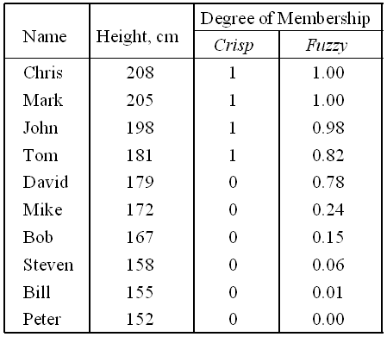
The classical example in fuzzy sets is tall men. The elements of the fuzzy set “tall men” are all men, but their degrees of membership depend on their height.

Slide 20
Crisp and fuzzy sets of “tall men”

Slide 21
The x-axis represents the universe of discourse – the range of all possible values applicable to a chosen variable. In our case, the variable is the man height. According to this representation, the universe of men’s heights consists of all tall men.
The y-axis represents the membership value of the fuzzy set. In our case, the fuzzy set of “tall men” maps height values into corresponding membership values.

Slide 22
A fuzzy set is a set with fuzzy boundaries.
Let X be the universe of discourse and its elements be denoted as x. In the classical set theory, crisp set A of X is defined as function f_{A}(x) called the characteristic function of A
f_{A}(x): X ® {0, 1}, where
This set maps universe X to a set of two elements.
For any element x of universe X, characteristic
function f_{A}(x) is equal to 1 if x is an element of set
A, and is equal to 0 if x is not an element of A.

Slide 23
In the fuzzy theory, fuzzy set A of universe X is defined by function m_{A}(x) called the membership function of set A
μ_{A}(x): X → [0, 1], where μ_{A}(x) = 1 if x is totally in A;
μ_{A} (x) = 0 if x is not in A;
0 < μ_{A} (x) < 1 if x is partly in A.
This set allows a continuum of possible choices.
For any element x of universe X, membership
function μ_{A}(x) equals the degree to which x is an
element of set A. This degree, a value between 0
and 1, represents the degree of membership, also
called membership value, of element x in set A.

Slide 24
How to represent a fuzzy set in a computer?
First, we determine the membership functions. In our “tall men” example, we can obtain fuzzy sets of tall, short and average men.
The universe of discourse – the men’s heights – consists of three sets: short, average and tall men. As you will see, a man who is 184 cm tall is a member of the average men set with a degree of membership of 0.1, and at the same time, he is also a member of the tall men set with a degree of 0.4.

Slide 25
Crisp and fuzzy sets of short, average and tall men

Slide 26

The notation for fuzzy sets: for the member, x, of a discrete set with membership µ, we use the notation µ/x . In other words, x is a member of the set to degree µ.
Discrete sets are defined as:
A = µ₁ /x₁+µ₂/x₂+…..+µ_{n}/x_{n}
or (in a more compact form)
x₁ ,x₂ , ….. x_{n} : members of the set A
µ₁, µ₂,…..µ_{n} : x₁ , x₂ ….. x_{n} ’s degree of membership.

Slide 27
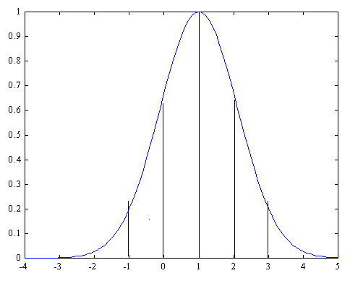

A continuous fuzzy set A can be defined as:
µ
Example: Discrete and Continuous fuzzy sets to represent the set of numbers “close to 1”
numbers

Slide 28
Various Types of Membership Functions
S-shaped function
Z-shaped function
Triangular Membership Function
Trapezoidal Membership Function
Gaussian Distribution Function
Pi function
Vicinity function

Slide 29
S-shaped function

Slide 30
Graphical Representation of S-Shaped Function

Slide 31
Z-Shaped Function
It represents an asymmetrical polynomial curve open to the left.
Z-membership function may be defined as follows:

Slide 32
Graphical Representation

Slide 33
Triangular membership functions

Slide 34
Cont…

Slide 35
Trapezoidal membership function

Slide 36
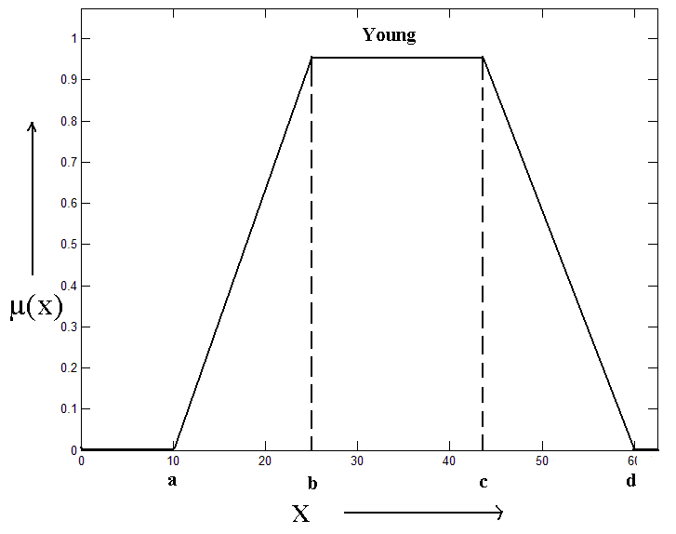
Cont…

Slide 37
Basic Operations
For reshaping the memebership functions, following three operations can be used.
  Dilation (DIL) : It increases the degree of membership of all members by spreading out the curve. For example, DIL(OLD) = more or less OLD. Its membership function is defined as: (µA (x)) 0.5
  Concentration (CON): It decreases the degree of membership of all members. For example CONS(OLD) = very OLD. Its membership function is defined as: (µA (x)) 2
  Normalization (NORM) : It discriminates all membership degree in the same order unless maximum value of any member is 1. Its membership function is defined as: µA(x) / max (µA(x)), x ∈ X
  A fuzzy set is called normalized when at least one of its elements attains the maximum possible membership grade i.e., 1.

Slide 38
Methods for Determining Membership Functions
Membership functions can be designed by analyzing the problem in hand.
There are many possible forms of membership functions.
Most of the actual fuzzy control operations are drawn from a small set of different curves.
The methods for determining membership functions may be broadly classified into the following categories which are explained briefly as follows:
  Trail and Error Basis
  Subjective evaluation and elicitation
  Converted frequencies or probabilities
  Physical measurement
  Learning and adaptation

Slide 39
Linguistic variables and hedges
At the root of fuzzy set theory lies the idea of linguistic variables.
A linguistic variable is a fuzzy variable. For example, the statement “John is tall” implies that the linguistic variable John takes the linguistic value tall.

Slide 40
In fuzzy expert systems, linguistic variables are used
in fuzzy rules. For example:
IF wind is strong
THEN sailing is good
IF project_duration is long
THEN completion_risk is high
IF speed is slow
THEN stopping_distance is short

Slide 41
The range of possible values of a linguistic variable represents the universe of discourse of that variable. For example, the universe of discourse of the linguistic variable speed might have the range between 0 and 220 km/h and may include such fuzzy subsets as very slow, slow, medium, fast, and very fast.
A linguistic variable carries with it the concept of fuzzy set qualifiers, called hedges.
Hedges are terms that modify the shape of fuzzy sets. They include adverbs such as very, somewhat, quite, more or less and slightly.

Slide 42
Fuzzy sets with the hedge very

Slide 43
Operations of fuzzy sets
The classical set theory developed in the late 19th
century by Georg Cantor describes how crisp sets can
interact. These interactions are called operations.

Slide 44
Cantor’s sets

Slide 45
Complement
Crisp Sets: Who does not belong to the set?
Fuzzy Sets: How much do elements not belong to
the set?
The complement of a set is an opposite of this set.
For example, if we have the set of tall men, its
complement is the set of NOT tall men. When we
remove the tall men set from the universe of
discourse, we obtain the complement. If A is the
fuzzy set, its complement ¬A can be found as
follows:
μ¬_{A}(x) = 1 − μ_{A}(x)

Slide 46
Containment
Crisp Sets: Which sets belong to which other sets?
Fuzzy Sets: Which sets belong to other sets?
Similar to a Chinese box, a set can contain other
sets. The smaller set is called the subset. For
example, the set of tall men contains all tall men;
very tall men is a subset of tall men. However, the
tall men set is just a subset of the set of men. In
crisp sets, all elements of a subset entirely belong to a larger set. In fuzzy sets, however, each element
can belong less to the subset than to the larger set.
Elements of the fuzzy subset have smaller
memberships in it than in the larger set.

Slide 47
Intersection
Crisp Sets: Which element belongs to both sets?
Fuzzy Sets: How much of the element is in both sets?
In classical set theory, an intersection between two sets contains the elements shared by these sets. For example, the intersection of the set of tall men and the set of fat men is the area where these sets overlap. In fuzzy sets, an element may partly belong to both sets with different memberships. A fuzzy intersection is the lower membership in both sets of each element. The fuzzy intersection of two fuzzy sets A and B on universe of discourse X:
μ_{A}∩_{B}(x) = min [μ_{A} (x), μ_{B} (x)] = μ_{A} (x) ∩ μ_{B}(x),
where x∈X

Slide 48
Union
Crisp Sets: Which element belongs to either set?
Fuzzy Sets: How much of the element is in either set?
The union of two crisp sets consists of every element
that falls into either set. For example, the union of
tall men and fat men contains all men who are tall
OR fat. In fuzzy sets, the union is the reverse of the
intersection. That is, the union is the largest
membership value of the element in either set. The
fuzzy operation for forming the union of two fuzzy
sets A and B on universe X can be given as:
μ_{A}∪_{B}(x) = max [μ_{A} (x), μ_{B}(x)] = μ_{A} (x) ∪ μ_{B}(x),
where x∈X

Slide 49
Operations of fuzzy sets

Slide 50
Additional operations
1. Equality: A = B, if µ_{A(x)} = µ_{B(x)}, ∀x ∈ X
2. Not equal: A ≠ B, if µ_{A(x)} ≠ µ_{B(x)} for at least one x ∈ X
3. Containment: A⊆ B if and only if µ_{A(x)} ≤ µ_{B(x)}, ∀x ∈ X
4. Proper subset: If A ⊆ B and A ≠ B
5. Product: A.B is defined as µ_{A.B(x)} = µ_{A(x)} . µ_{B(x)}
6. Power : A^{N} is defined as: µ_{A}^{N(x)} = (µ_{A(x)})^{N}
7. Bold union : A ⊕ B is defined as:
µ_{A} _{⊕ B(x)} = Min [1, µ_{A(X)} + µ_{B(x)}]
8. Bold intersection: A Ο B is defined as:
µ_{A} _{Ο B(x)} = Max [0, µ_{A(x)} + µ_{B(x)} - 1]

Slide 51
Fuzzy rules
In 1973, Lotfi Zadeh published his second most
influential paper. This paper outlined a new
approach to analysis of complex systems, in which
Zadeh suggested capturing human knowledge in
fuzzy rules.

Slide 52
What is a fuzzy rule?
A fuzzy rule can be defined as a conditional
statement in the form:
IF x is A
THEN y is B
where x and y are linguistic variables; and A and B
are linguistic values determined by fuzzy sets on the
universe of discourses X and Y, respectively.

Slide 53
What is the difference between classical and
fuzzy rules?
A classical IF-THEN rule uses binary logic, for example,
Rule: 1 Rule: 2
IF speed is > 100 IF speed is < 40
THEN stopping_distance is long THEN stopping_distance is short
The variable speed can have any numerical value
between 0 and 220 km/h, but the linguistic variable
stopping_distance can take either value long or short.
In other words, classical rules are expressed in the
black-and-white language of Boolean logic.

Slide 54
We can also represent the stopping distance rules in a fuzzy form:
Rule: 1 Rule: 2
IF speed is fast IF speed is slow
THEN stopping_distance is long THEN stopping_distance is short
In fuzzy rules, the linguistic variable speed also has
the range (the universe of discourse) between 0 and
220 km/h, but this range includes fuzzy sets, such as
slow, medium and fast. The universe of discourse of
the linguistic variable stopping_distance can be
between 0 and 300 m and may include such fuzzy
sets as short, medium and long.

Slide 55
Fuzzy rules relate fuzzy sets.
In a fuzzy system, all rules fire to some extent, or in other words they fire partially. If the antecedent is true to some degree of membership, then the consequent is also true to that same degree.

Slide 56
Fuzzy sets of tall and heavy men
These fuzzy sets provide the basis for a weight estimation
model. The model is based on a relationship between a
man’s height and his weight:
IF height is tall
THEN weight is heavy

Slide 57
The value of the output or a truth membership grade of
the rule consequent can be estimated directly from a
corresponding truth membership grade in the
antecedent. This form of fuzzy inference uses a
method called monotonic selection.

Slide 58
A fuzzy rule can have multiple antecedents, for
example:
IF project_duration is long
AND project_staffing is large
AND project_funding is inadequate
THEN risk is high
IF service is excellent
OR food is delicious
THEN tip is generous

Slide 59
The consequent of a fuzzy rule can also include multiple parts, for instance:
IF temperature is hot
THEN hot_water is reduced;
cold_water is increased

