Slide 1
Computational Intelligence
CSE-5203
Department of Computer Science and Engineering
Comilla University, Cumilla

Slide 2
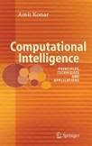
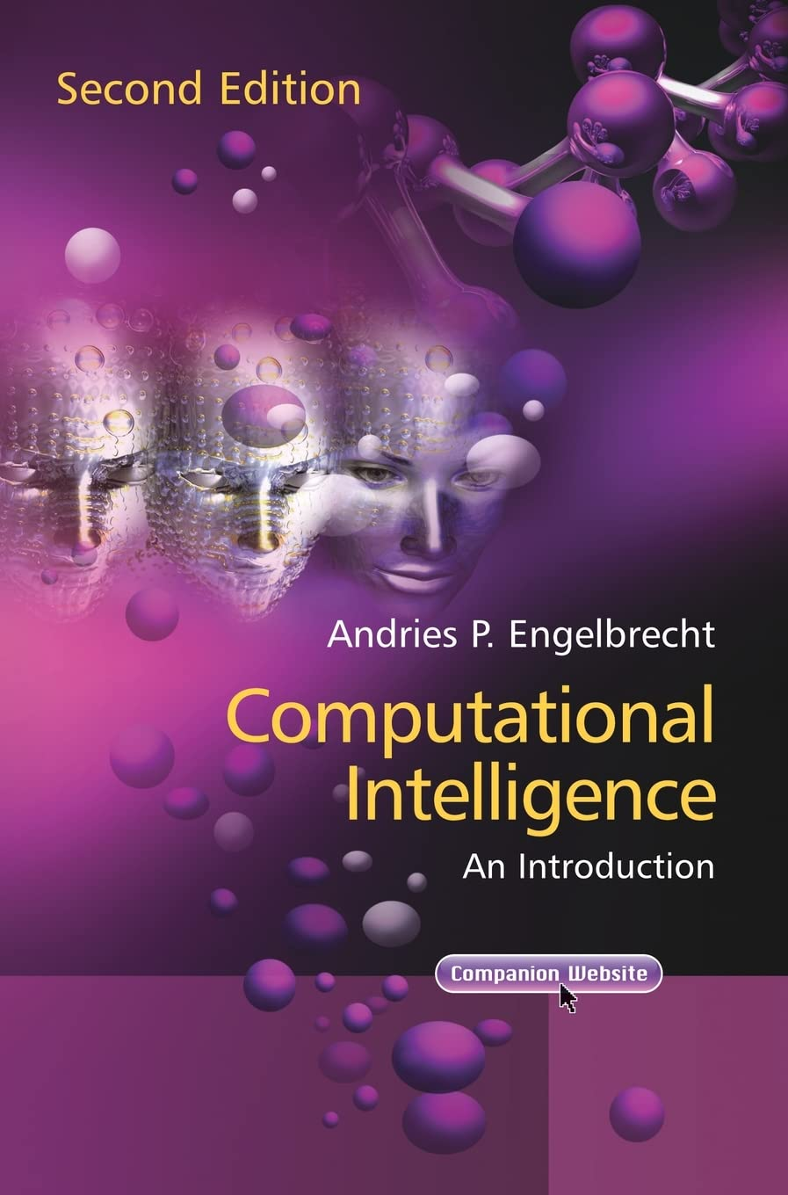
References
Computational Intelligence: Principles, Techniques and Applications
-Amit Konar
Computational Intelligence: An Introduction -Andries P Engelbrecht
Notes:
1. Digital Image Processing
- Rafael C. Gonzalez and Richard E. wood
- https://dl.icdst.org/pdfs/files4/01c56e081202b62bd7d3b4f8545775fb.pdf
2. Signal and Linear System Analysis
- Gordon E. Carlson
- https://typeset.io/pdf/signal-and-linear-system-analysis-1cm7h8xljb.pdf

Slide 3
Computational Intelligence
Computational Intelligence-
The computational models and tools of intelligence capable of inputting raw numerical sensory data directly, processing them by exploiting the representational parallelism and pipelining of the problem, generating reliable and timely responses and withstanding high fault tolerance.

Slide 4
Computational Intelligence
Four major aspects-
First a computationally intelligent system should be able to receive and interpret raw sensory data.
  - test the capability of the system to handle numerical data
Secondly, it must have the capability to detect the possible pipelining and parallelism in the underlying problem.
example-
    z=(a+b)/(a-b)

Slide 5
Computational Intelligence
Four major aspects-
Third is the power of generating reliable and timely responses
  - computational errors should be less and the responses should be timely
  The last issue refers to high fault tolerance
  - require multiplicity of computational resources in the realization of the computational models

Slide 6
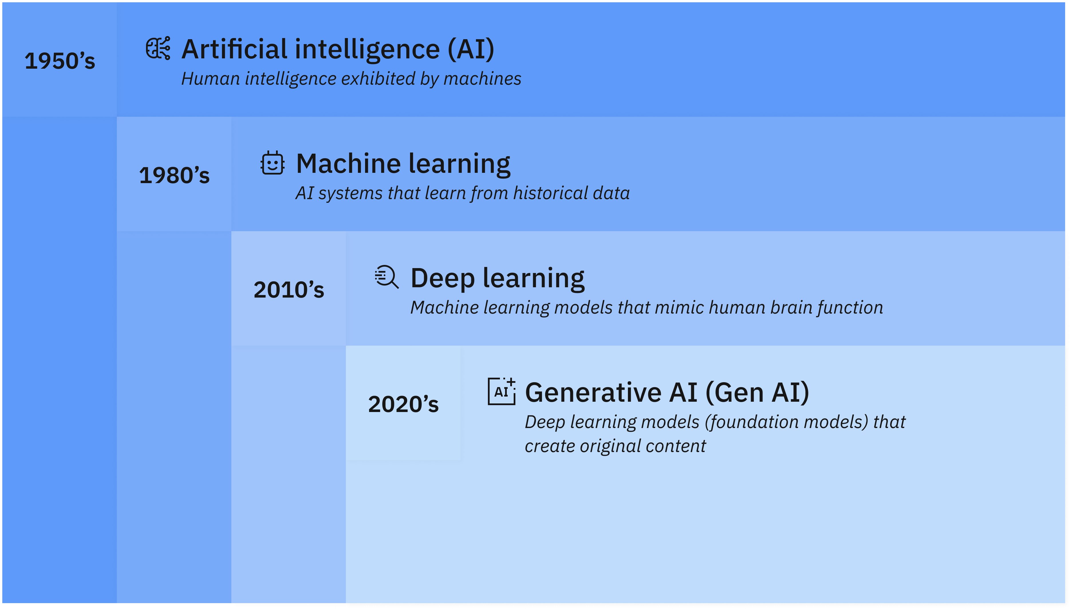
Artificial Intelligence
Artificial intelligence (AI) is technology that enables computers and machines to simulate human learning, comprehension, problem solving, decision making, creativity and autonomy

Slide 7
Artificial Intelligence
Based on Capability
Narrow AI (Weak AI): Designed for specific tasks (e.g., facial recognition, voice assistants like Siri or Alexa).
General AI (Strong AI): Hypothetical AI that can perform any intellectual task a human can do. This does not yet exist.
  - Sophia the Robot (an advanced humanoid but still consider Narrow AI).
Super AI: An AI that surpasses human intelligence in all domains. This is a theoretical concept and remains a topic of debate.
  - AI that can make ethical and emotional decisions (Currently, this level of AI does not exist.)

Slide 8
Artificial Intelligence
Based on Functionality
Reactive AI-
AI that reacts based on predefined rules and does not have memory or learning capabilities.
Examples:
  IBM’s Deep Blue – Chess-playing AI that defeated a world champion.
  Spam Filters – Identify and block unwanted emails.

Slide 9
Artificial Intelligence
Based on Functionality
Limited Memory AI-
AI that learns from past experiences and improves its performance over time.
Examples:
  Self-driving cars – Use past data to navigate roads.
  Chatbots like ChatGPT – Learn from previous interactions

Slide 10
Artificial Intelligence
Based on Functionality
Theory of Mind AI (Future AI)-
AI that can understand emotions, beliefs, and thoughts (not yet developed).
Examples:
  - Advanced humanoid robots that can interact with emotions.
Self-Aware AI (Future AI)-
AI that has consciousness and self-awareness.
Examples:
  - A fully sentient AI (not yet in existence).

Slide 11
Heuristic Search
- fundamental in AI for problem-solving, path finding, and decision-making.
- make intelligent decisions by prioritizing paths that are more likely to lead to the goal efficiently.
Characteristics-
- Do not guarantee the best solution but provide good enough solutions.
- Reduce computational complexity.
- Used when exact solutions are impractical

Slide 12
Key Concepts of Heuristic Search
1. Heuristic Function (h(n))
A function that estimates the cost or distance from a node to the goal.
Example: In a GPS navigation system, the heuristic could be the straight-line distance to the destination.
2. Evaluation Function (f(n))
Some algorithms use an evaluation function, which is typically defined as:
f(n)=g(n)+h(n)
g(n) = Cost from the start node to the current node.
h(n) = Estimated cost from the current node to the goal.

Slide 13
Applications of Heuristic Search Algorithms
1. Pathfinding- GPS, robot navigation, video game AI
2. AI in Games- Chess, Pac-Man, strategic decision-making
3. Optimization- Scheduling, logistics, network routing
4. Machine Learning- Feature selection, hyperparameter tuning
5. Robotics- Autonomous vehicle path planning

Slide 14
Heuristic Search Algorithms
Examples of Heuristic Algorithms
A* Algorithm – Uses heuristics to find the shortest path (e.g., Google Maps).
Simulated Annealing – Solves optimization problems by exploring different solutions.
Genetic Algorithms – Mimic natural evolution to optimize solutions.
Tabu Search – Avoids previously visited solutions to improve performance

